Slide 1
The 17th Japan Conference on Discrete and Computational Geometry and Graphs
Polynomial-Time Algorithm for
Sliding Tokens on Trees
Erik D. Demaine
MIT, USA
Martin L. Demaine
MIT, USA
Eli Fox-Epstein
Brown University, USA
Duc A. Hoang
JAIST, Japan
Takehiro Ito
Tohoku University, Japan
Hirotaka Ono
Kyushu University, Japan
Ryuhei Uehara
JAIST, Japan
Yota Otachi
JAIST, Japan
Takeshi Yamada
JAIST, Japan
September 15, 2014

Slide 2
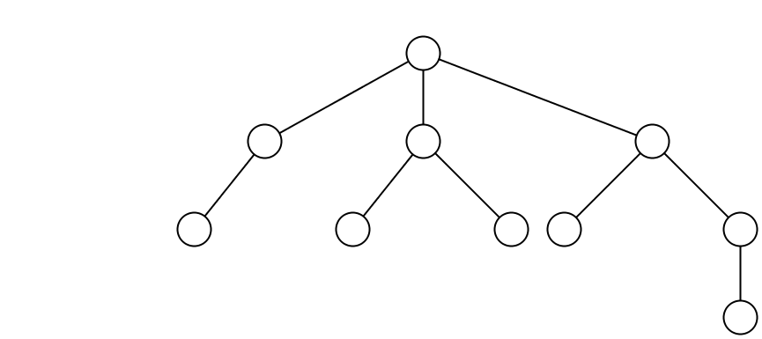
Independent set
Let $G=(V,E)$ be a graph with $n$ vertices, $m$ edges.
A set of vertices $I$ is independent if for any two vertices $u, v∈I$, $uv∉E(G)$.
An independent set
Not an independent set

Slide 3
Independent set reconfiguration problem (ISRECONF)
GIVEN
Two independent sets $I, I′$ with $\left|I\right|=|I′|$. A token (coin) is placed at each vertex of $I$.
Reconfiguration rules
Token Sliding (TS)
A token can be moved to one of its neighbors.
Token Jumping (TJ)
A token can jump from one vertex to another vertex.
Token Addition and Removal (TAR)
Add or remove some tokens, but there is always at least $t$ tokens.
PROBLEM
Can we reconfigure $I$ to $I′$ using one of the given rules such that all intermediate sets of tokens are independent?

Slide 4
ISRECONF under TS rule
Let $I, I′$ be two independent sets of a graph $G$.
$$I$$
$$I′$$
$$\left|I\right|=|I′|$$
YES (why?)
Question: Can we reconfigure $I$ to $I′$ using TS rule such that all intermediate sets of tokens are independent?

Slide 5
ISRECONF under TS rule
Let $I, I′$ be two independent sets of a graph $G$.
$$I$$
$$I′$$
$$\left|I\right|=|I′|$$
NO (why?)
Question: Can we reconfigure $I$ to $I′$ using TS rule such that all intermediate sets of tokens are independent?

Slide 6
ISRECONF under TS rule
PSPACE-complete
Polynomial
general
Open
A
B
B is a subclass of A
P, NP or PSPACE?
perfect
planar
chordal
bipartite
distance-hereditary (D.H)
interval
Ptolemaic
bipartite D.H.
trivial perfect
proper interval
block
tree
Our Result

Slide 7
Why study the problem for trees?
Trees (connected + no cycle) are very simple. Almost every problem can be solved in polynomial time for trees. This also holds for the ISRECONF problem.
Kaminski et. al. (2012) gave a linear time algorithm for trees under TJ and TAR rules.
The answer is always YES.
Tokens never make detours.
Not true for TS rule.

Slide 8
Key concept – Rigid tokens
Intuitively, a token $u$ is rigid if there is no way to slide $u$.
$(T, I)$-rigid tokens
$(T,I)$-movable tokens
Claim:
All rigid tokens can be determined in $O(n^{2})$ time.
If there are no $(T,I)$-rigid and $(T,I′)$-rigid tokens, $I$ can be transformed to $I′$.
Non-trivial

Slide 9
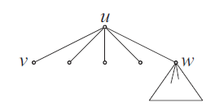
Reconfigure non-rigid tokens
Let $I, I′$ be two independent sets of a graph $G$.
$$I$$
$$I′$$
$$\left|I\right|=|I′|$$
?
Order of sliding.
Detour.
Idea:
Find a safe degeree-1 vertex $v$.
Move a red and a black token to $v$.
Remove $v$ and its unique neighbor.
Repeat the steps.

Slide 10
Polynomial time algorithm
Step 1: Find all $(T, I)$-rigid and $(T,I′)$-rigid tokens. If the two sets are different, return NO. Otherwise go to Step 2.
Step 2: Delete all rigid tokens and their neighbors. Compare the number of tokens in each component of the obtained forest. If they are the same, return YES. Otherwise, return NO.
$$I$$
$$I′$$
$\left|I\right|=|I′|$ = 5
NO
YES

Slide 11
Open problems
PSPACE-complete
Polynomial
general
Open
A
B
B is a subclass of A
perfect
planar
chordal
bipartite
distance-hereditary (D.H)
interval
Ptolemaic
bipartite D.H.
trivial perfect
proper interval
block
tree

Slide 12
The 17th Japan Conference on Discrete and Computational Geometry and Graphs
Thank you for your attention!
Erik D. Demaine
MIT, USA
Martin L. Demaine
MIT, USA
Eli Fox-Epstein
Brown University, USA
Duc A. Hoang
JAIST, Japan
Takehiro Ito
Tohoku University, Japan
Hirotaka Ono
Kyushu University, Japan
Ryuhei Uehara
JAIST, Japan
Yota Otachi
JAIST, Japan
Takeshi Yamada
JAIST, Japan

